Slide 1
Codehouse
Working with GoLang
(See Also https://github.com/KernelGamut32/golangclass)

Slide 2
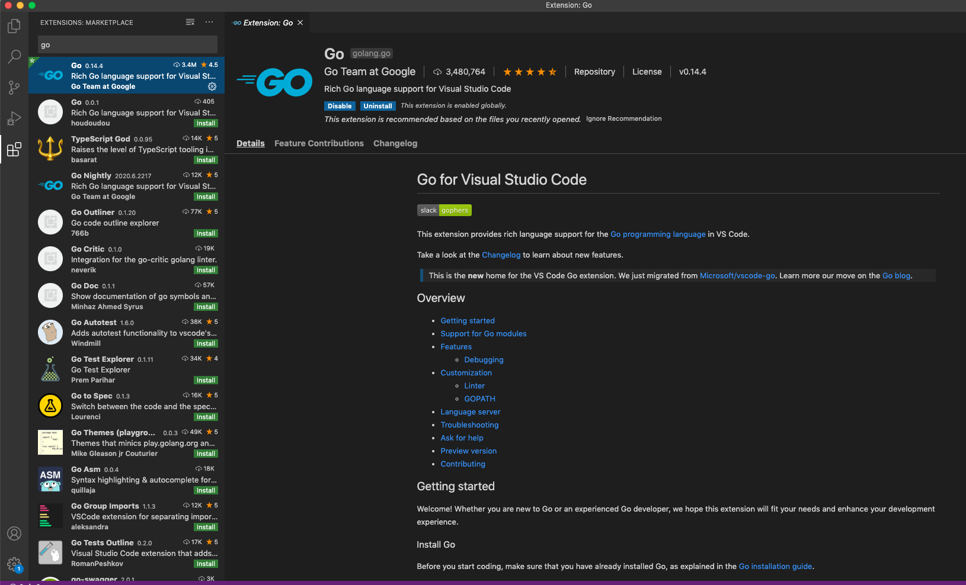
Installing GO on Visual studio code - Step 1
From the left pane choose the extension icon and install the go plugin

Slide 3
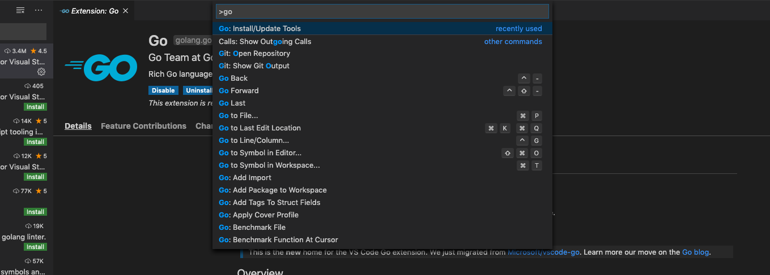
Installing GO on Visual studio code - Step 2
Press ctr+shift+p and enter go in the text box

Slide 4
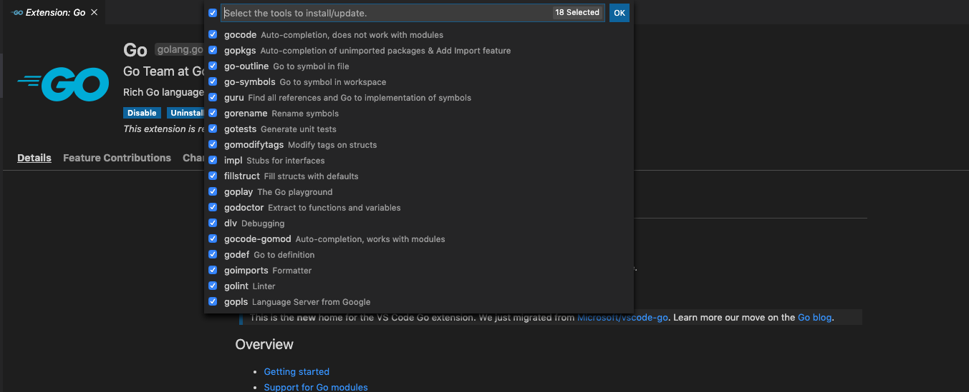
Installing GO on Visual studio code - Step 3
Select all the packages from the list and press enter

Slide 5
GOROOT and GOPATH
When you install Go on your system, it creates a directory /usr/local/go in UNIX or c:/go in Windows. Then it copies all necessary code and binaries needed for Go to function in this directory.
GOROOT env var points there as the path where the go installation lives, alongside the complete standard library, and usually you don’t need to change it
If somehow, your Go installation directory is different than what Go assumes for the location, you can change GOROOT environment variable.
GOPATH is for all other dependent projects not in the standard library, GOPATH/src for the project source, GOPATH/bin is for executables outside the standard go distribution
The default location of $GOPATH is $HOME/go, and it's not usually necessary to set GOPATH explicitly.

Slide 6
Managing a Project in Go - workspaces reminder
The legacy way of organizing a project in go is called a workspace
Prior to go 1.13 go used workspaces in order to gather all the files necessary for a project
Woking in workspace mode means that all of our project related files needs to be in one place referenced by the GOPATH environment variable
When we used to install any dependency packages using go get command, it would save the package files under the $GOPATH/src path
Every dependency must be retrieved using go get prior to utilizing

Slide 7
Managing a Project in Go - workspaces reminder
When you download a package using go get, you are are cloning the master repository at the most recent commit
you can’t install multiple versions of the same dependency package
A Go program couldn’t import a dependency unless it was present inside $GOPATH
Also, the go build command creates binary executable files and package archives inside $GOPATH. Hence, GOPATH used to be a big deal in Go. The downside here is that we need to create all of our projects in one directory, or constantly change our GOPATH.
pkg is where go installs the compiled binaries of third party dependencies, Whenever you install a 3rd party package, a package object package-name.a is created for that package in this directory.

Slide 8
Introducing Go Modules
Go modules gives us a built-in dependency management system
As of go 1.13 modules are the official way to organise our source code as a project
A module is nothing but a directory containing Go packages. These can be distribution packages or executable packages.
A module can also be treated as a package that contains nested packages.
A module is also like a package that you can share with others
Modules allows us to work from any directory, not just GOPATH which gives us the flexibility to relocate our source code anywhere

Slide 9
Introducing Go Modules
Go modules are stored inside $GOPATH/pkg/mod/cache directory (module cache directory). (Seems like we haven’t been able to get rid of $GOPATH at all. But Go has to cache modules somewhere on the system to prevent repeated downloading of the same modules of the same versions).
Modules allows us to install the precise version of a dependency package to avoid breaking changes.
Using modules we are able to import multiple versions of the same dependency package
Like package.json in NPM, each module has a go.mod file that houses the dependencies for our project
If we do -> import "github.com/username/packagename"
In the above package import statement, the package name looks like a URL, because it is. Go can download and install packages located anywhere on the internet.

Slide 10
Creating Go Modules
Unlike Workspaces when using modules we don't need to start under a folder structure (src,pkg and bin directories)
We start from an empty directory and executing the following
$ go mod init github.com/gameserver
*As you can see we passed to init a module identifier
module github.com/gameserver
go 1.14

Slide 11
Retrieving Dependencies
Often we will need to use third party libraries
As we did before with workspaces , we can run the following to fetch a dependent lib
$ go get github.com/gorilla/mux
Please note the indirect comment, this is due to the fact that we are listing the module but not using it.
Once we use the mux router the indirect
comment will go away stating it knows that
we are using the dependency
module github.com/gameserver
go 1.14
require (
github.com/gorilla/mux v1.7.4 // indirect
)

Slide 12
Retrieving Dependencies
We don't see the gorilla/mux on our path like we used to when using workspaces
Go download can cache it for us, (it is located under the $GOPATH/pkg/mod/cache)

Slide 13
Listing Dependencies
Occasionally you will need to know what dependencies your module relies on
If we invoke the $ go list all command we will be able to see all the packages that our module relies on
But if we wish to only get the modules we can execute we can use $ go list -m all
We can also retrieve all the versions a module has by executing
$ go list -m -versions github.com/gorilla/mux

Slide 14
How go Verifies Dependencies
When we retrieve a dependency, go creates another file called go.sum
When a dependency is being retrieved, go creates a unique hash and assigns it to the dependency
The hash is unique based on the source code of the specific version that was retrieved
The main reason for this is to make sure that the dependent module was not tampered with in any way
To validate that the modules an app contain has not been modified we can issue the following command $ go mod verify

Slide 15
Cleaning unused Dependencies
Sometimes we no longer need a dependency, and wish to remove it so that our app will be as lean as possible
go has no way of knowing if we stopped using a dependency unless it rebuilds the entire dependency graph, which is a heavy operation
$ go mod tidy will do that for us

Slide 16
Semantic Versioning With Modules
Semantic versioning is applied to a go system in a very strict way
An example for a version number -> v1.6.8
The v letter is a must and it indicates that we are talking about a version
The first digit “1” after the v indicates a major revision – when moving to a higher number it does not guarantee backward compatibility, but any version starting with that same value should be backwards compatible
The second digit after the dot “6” indicates minor revision, telling us is that the module has new features but backward compatibility remains intact (or should)
The last digit after the last dot “8” is the patch, it promises not to introduce new features but only to fix bugs

Slide 17
Versioning rules for go modules
All versions prior to v1 do not have to preserve backward compatibility
Backward compatibility should be preserved within major versions
Each Major version should pass a version identifier with a unique path with a suffix that entails the version for example:
import github.com/gorilla/mux/v2
The reason for this is to allow us to upgrade the version in a gradually measured way

Slide 18
Organizing major module versions
Usually we will use the “main” or “master” branch for the main v1 of our module
Every additional major revision can be added to a different branch
Need to remember to add a tag to this newly created branch to mark the new version
Also we should update the module name with the suffix for it’s new version for example github.com/example/v3
We can use more than one major revision of a module in our project provided that we’ve added an alias in the import section
module github.com/gameserver/v3
go 1.14
import (
"rsc.io/quote"
quotev3 "rsc.io/quote/v3"
)

Slide 19
Importing unversioned modules
What happens when we need to use a module that does not have any major.minor.patch semver?
The short answer is that the go tooling will fix it in a way to allow us to import much as we did before with semver
The long answer is that the go tooling will create a prerelease semver based on the latest commit hash and timestamp – for example, if we import golang.org/x/tools we will have in our go.mod file:
golang.org/x/tools v0.0.0-20200622192924-4fd1c64487bf

Slide 20
Requesting a Specific Module
The module system allows us to request a specific module by using the @ sign for example $ go get github.com/gorilla/mux@v1.6.1
We could also ask for a version with the following :
Version prefix: just use for example @v1 and it will fetch the latest version with this major revision
@latest : will fetch the latest version from the repo
Specific commit : for example @c55772
@master: will fetch the head of master, the latest commit
Comparison operator: @>=1.5.0 , we are asking for a version greater or equal to 1.5.0,always remember that the closest match wins

Slide 21
Go mod additional commands
$ go mod why github.com/rsc.io/quote builds a dependency tree in order to show us the modules that use it and all the modules required by it
$ go mod graph will show you a tree of all the modules in your app and their dependent modules
If you need to point to the local version of a dependency in Go rather than the one over the web, use the edit option with the replace argument
$ go mod edit -replace github.com/rsc.io/quote=/Users/motiso/Projects/quote

Slide 22
Go mod additional commands
$ go mod download github.com/rsc.io/quote is used to download the module into the build cache so it will be available for later builds
The `go mod vendor` command will create a vendor folder and will hold all the dependencies in that location; it might be useful for organizations that do not want a production build server to retrieve the dependency from the internet
To use the vendor directory you need to use $ go run -mod vendor . Please note that all dependencies must be in the vendor directory as go will not mix it with what is in the cache

Slide 23
Go Project Structure
As your project grows, keep in mind that it'll be important to make sure your code is well structured; otherwise you'll end up with messy code with lots of hidden dependencies and global state
The following is just a recommendation for a basic layout for Go application projects based on a set of common historical and emerging project layout patterns in the Go ecosystem
GO Directories
/cmd - the main application go file should be placed in this directory, if you have other executables each should be placed in a sub directory (for example /cmd/myutil)
/internal - Private application and library code; this is the code you don't want others importing in their applications or libraries
/pkg - Library code that's ok to use by external applications (e.g., /pkg/mypubliclib). Other projects will import these libraries expecting them to work, so think twice before you put something here :-)
/vendor - Application dependencies (managed manually or by your favorite dependency management tool like the new built-in Go Modules feature)
/web - Web application specific components: static web assets, server side templates and SPAs
And more … https://github.com/golang-standards/project-layout
Notes:
/cmd - (The directory name for each application should match the name of the executable you want to have)

Slide 24
Let’s Code!!

Slide 25
Thank you !

